Slide 1
BIG DATA CHALLENGE 0
MAGESH RAJASEKARAN
UNM ID: 101676478
Email: mrajasekaran@unm.edu
THILAK RAJ BALASUBRAMANIAN
UNM ID: 101622696
Email: trajbalasubramanian@unm.edu

Slide 2
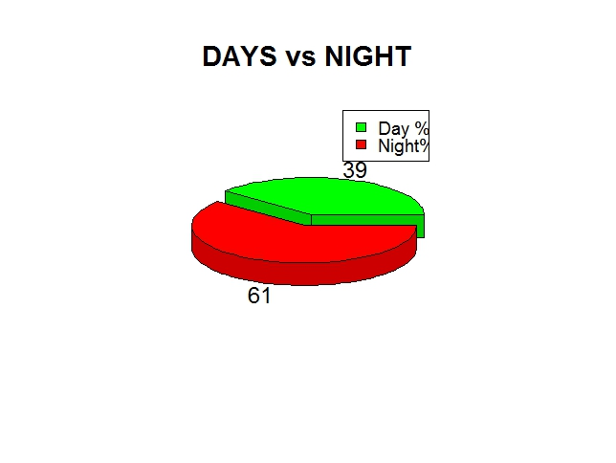
TASK 1:CAR SERVICES – DAY Vs NIGHT
Day Assumption : From Morning 6 A.M. to Evening 6 P.M.
Night Assumption: From Evening 6 P.M. to Morning 6 A.M.
Formatting the timestamp using strptime function and Parsing the timestamp we get two datasets of day and night
Lubridate and daytime Libraries are used
Calculating the average percentage from the two datasets
3D Pie chart is drawn using pie3dD Function
OSM Map is drawn using ggmap Function for both Day and Night Trips

Slide 3
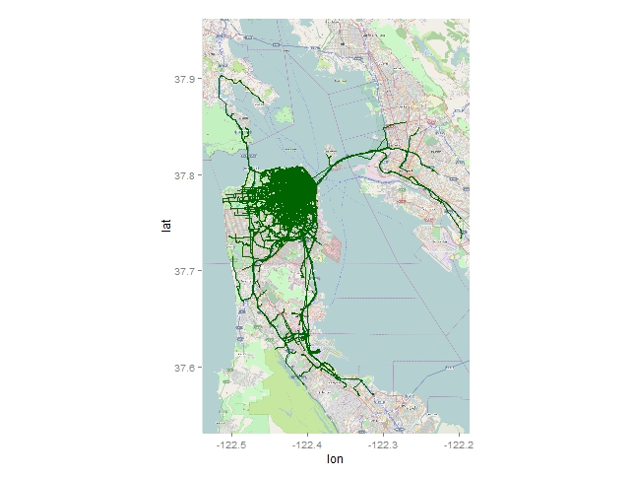
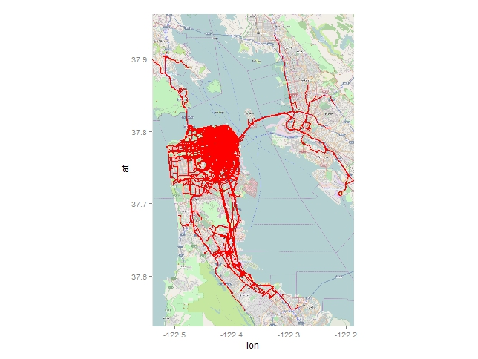
DAY Vs NIGHT - MAP
DAY MAP
NIGHT MAP

Slide 4
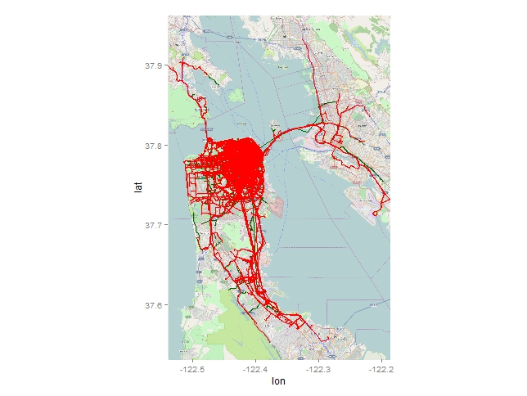
DAY and NIGHT MAP

Slide 5
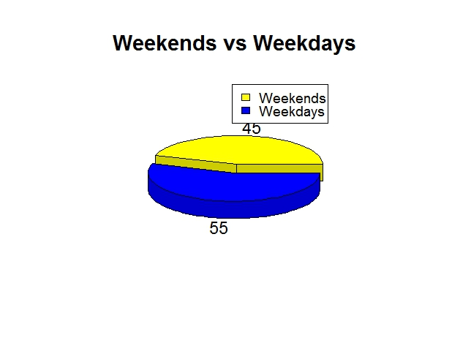
TASK2:WEEKEND Vs WEEKDAY
Days of the week from the Timestamp is calculated using day function
car.data_days$week_day<-wday(car.data_days$V2)
2 separate datasets of weekdays and weekends
Calculation of Average Percentage of weekdays and weekends
3D Pie chart is drawn using pie3D Function
OSM(Open Street Map) Map is drawn using ggmap Function for both weekday and weekend trips

Slide 6


WEEKEND Vs WEEKDAY MAP
WEEKEND MAP
WEEKDAY MAP

Slide 7
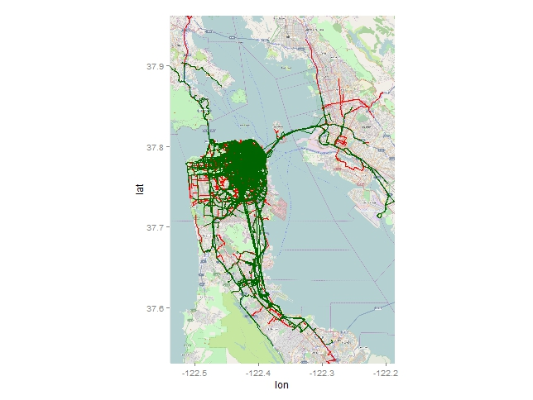
WEEKEND and WEEKDAY MAP

Slide 8
TASK3: LONGEST AND SHORTEST TRIP OF DAY AND NIGHT
Two datasets of day and night trips are retrieved from the given data
Day Assumption : From Morning 6 A.M. to Evening 6 P.M.
Night Assumption: From Evening 6 P.M. to Morning 6 A.M.
Longest trip and shortest trip of the car is determined by the frequency of the car’s trip in the column 1.
Frequency of the car’s trip data was calculated using count function.
The calculated data have been sorted in order to find the first five maximum numbers and first five least numbers.
OSM map is plotted using GGMAP function for the top five and least five values for Day and Night.

Slide 9
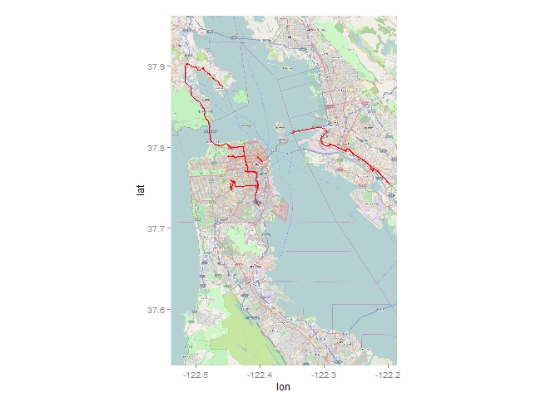
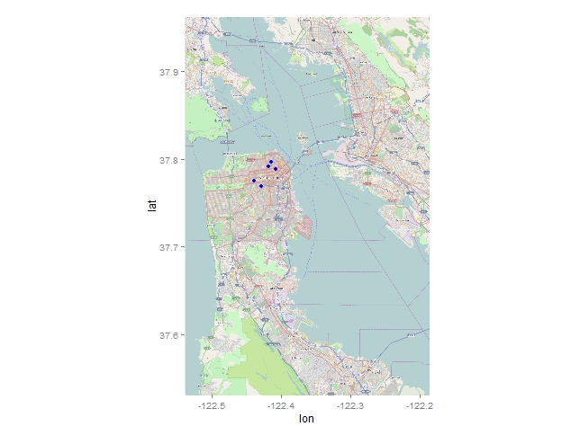
LONGEST AND SHORTEST TRIP OF DAY
TOP 5
LEAST 5

Slide 10
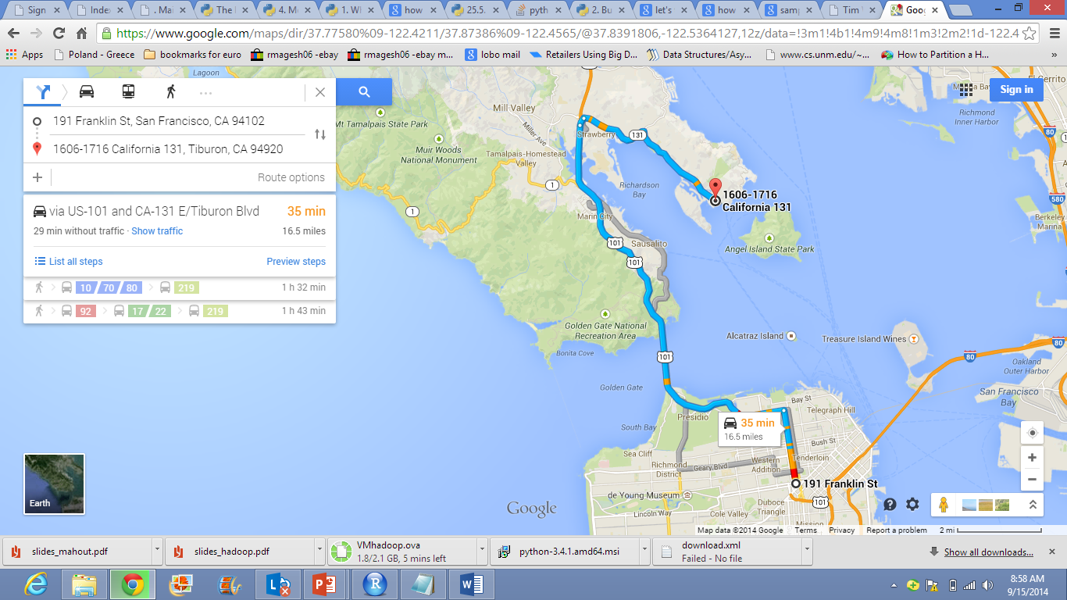
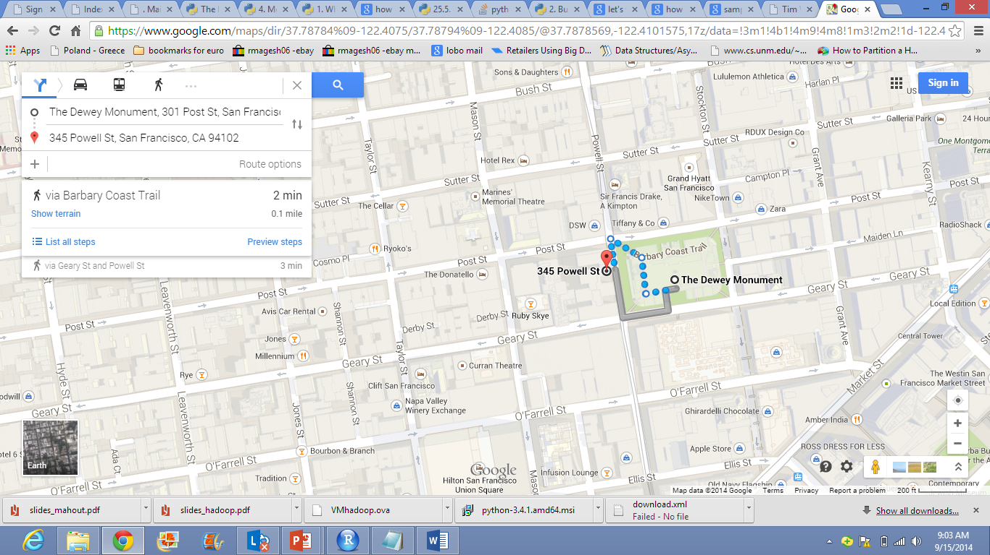
Day’s longest and shortest trip
Day’s Longest- (16.5 Miles) From: 191, Franklin, San Francisco To: California 131, Tiburon
Day’s shortest- (0.1 Miles) From: 345 Powel St. To: The Dewey Monument

Slide 11
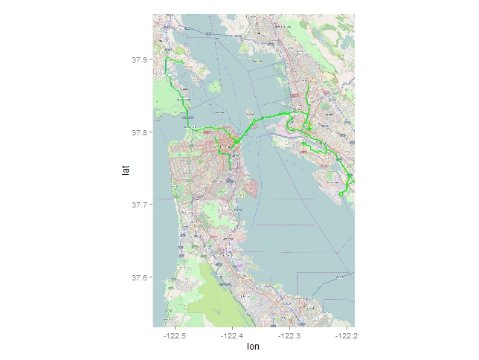

LONGEST AND SHORTEST TRIP OF NIGHT
TOP 5
LEAST 5

Slide 12
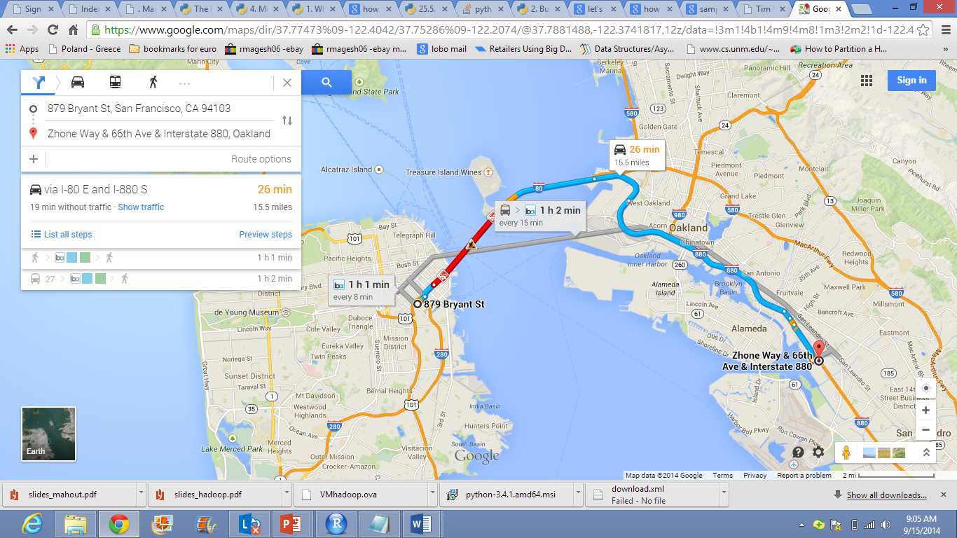
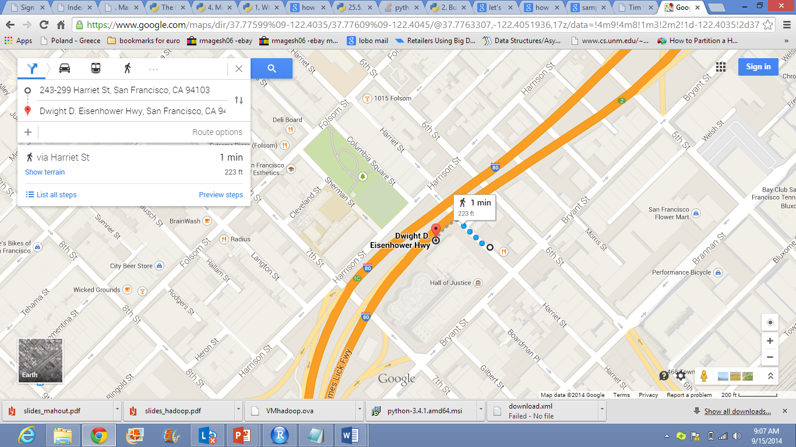
Night’s longest and shortest trip
Night’s longest- (15.5 Miles) From: Zhoneway, 66th Ave To: Bryant st, San Francisco
Night’s shortest- (0.2 Miles) From: 243, Harnier st, San Francisco To: Dwight D. Eisenhewer, San Francisco

Slide 13
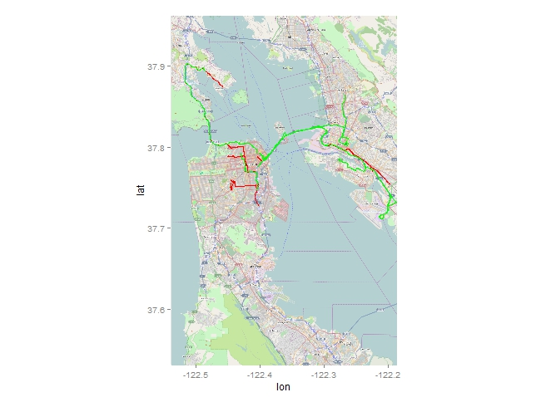

LONGEST AND SHORTEST TRIP OF DAY AND NIGHT
TOP5
LEAST 5

Slide 14
References:
http://www.statmethods.net/graphs/pie.html
https://stat.ethz.ch/R-manual/R-patched/library/base/html/strptime.html
http://docs.ggplot2.org/0.9.3.1/geom_point.html
http://rprogramming.net/r-order-to-sort-data/
http://www.scienceisdelicious.net/?tag=r
Help commands in R Studio.

Slide 15
Attachments:

Slide 16


